Slide 1
SAP HANA Direct Extractor Connection Overview

Slide 2

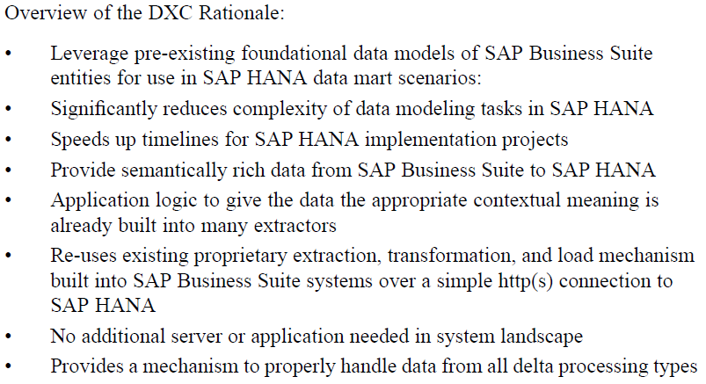

Slide 3
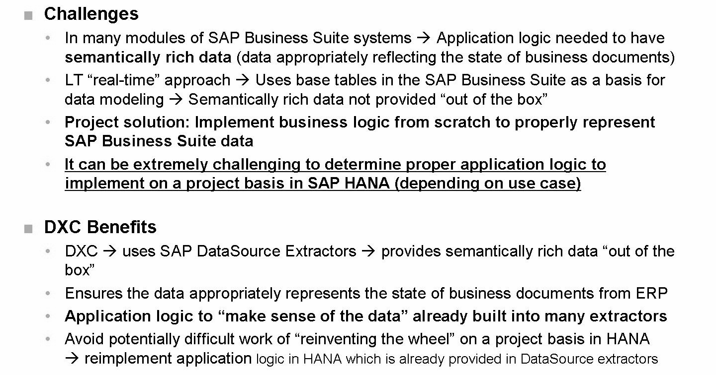

Slide 4
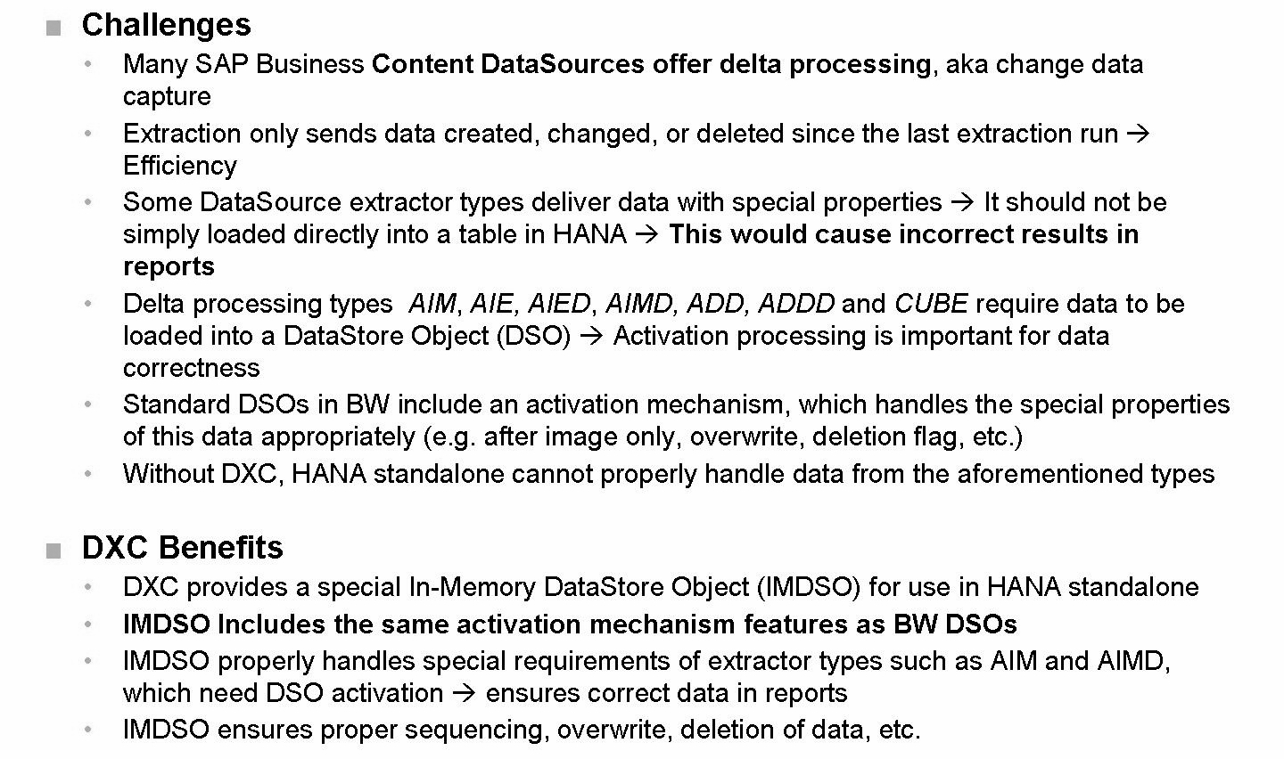

Slide 5
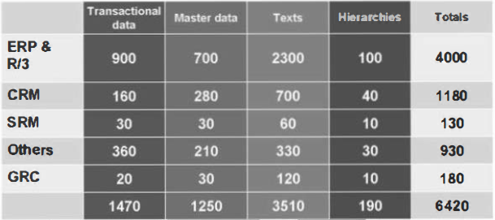
SAP delivered pre-defined extractors
Proprietary Extraction Technology
Application based change data capture (aka delta capabilities)
Extractors are application based and take data from the context of the application itself
Extract structures can easily be enhanced using append structures
Transformations can be implemented at the time of extraction using Business Add Ins (BADls)
Extract Structures based on entities in the Business Suite
Asynchronous, mass data capable extraction

Slide 6
Technical details
In typical business suite systems, the embedded BW is not utilized
Customers typically have separate BW systems
DXC uses the embedded BW system to enable extraction and monitoring only
Data flow is redirected and gets sent to HANA
Note: An architectural variation available, which uses a "sidecar" BW instead of the embedded one.
The extraction from the SAP Business Suite system -> controlled from the Data Warehousing workbench inside the embedded BW
When data is extracted from, the SAP Business Suite system, it is not loaded into the PSA of the embedded BW Instead it is redirected and sent to HANA
It gets loaded into in-memory DSO's activation queue
Then activated into the active table of the in-memory
However, in the data load monitor of the embedded BW, the data load into the activation queue in the DSO in HANA appears like data is loading into the PSA in the embedded BW
Delta processing (aka "change data capture") works the same for DXC as it would if BW were the receiving system
If the DataSource is delta enabled, then delta-enabled data is available with SAP HANA Direct Extractor Connection
DXC internally in HANA uses the ICM (Internet Connectivity Manager) - receives XML packages over the http(s) connection
Both the ICM and XS Engine components must be installed in SAP HANA to utilize DXC

Slide 7
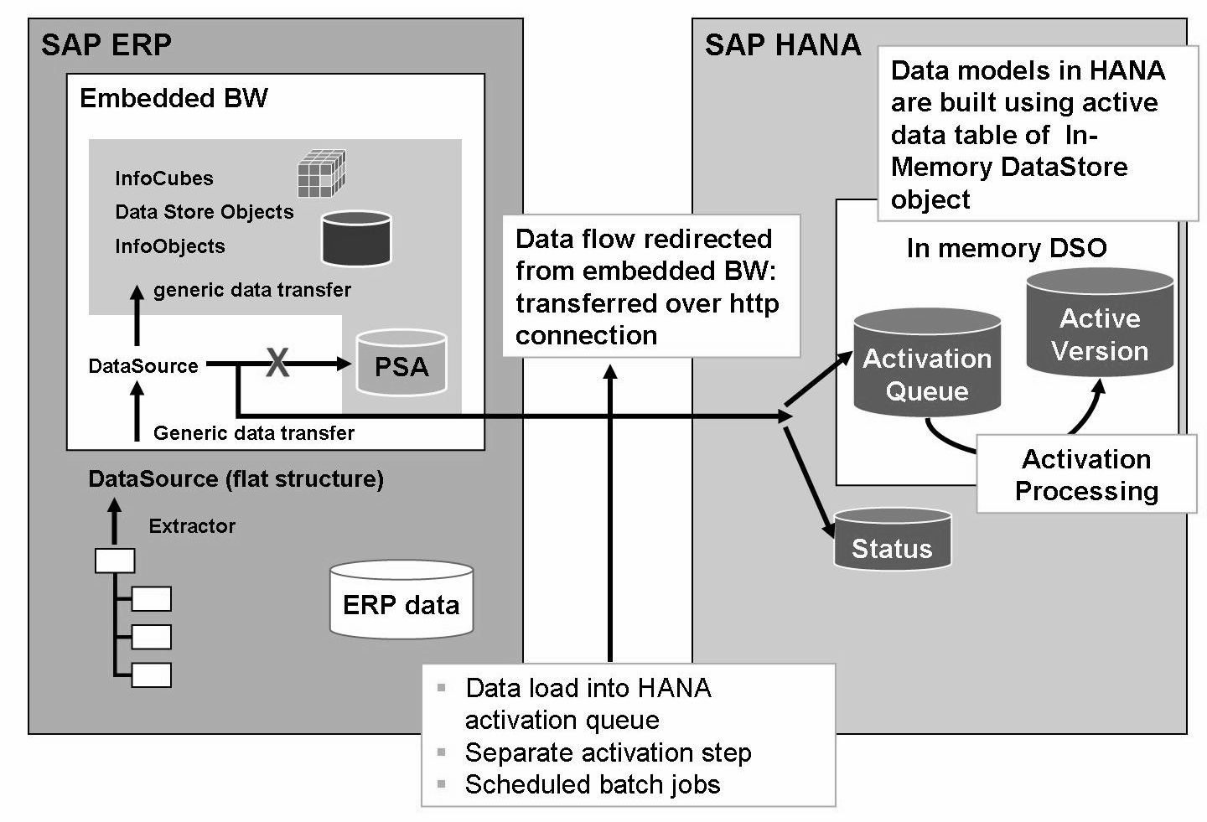
SAP HANA DXC Concept: Illustration
Limitations for DXC
Business Suite System based on NetWeaver 7.0
DataSource must have a key field defined
Procedure exists t o define a key if one is not already defined
Certain DataSources may have specific limitations
Inventory types, e.g. 2US_03_BF - data requires special features only available in BW

Slide 8
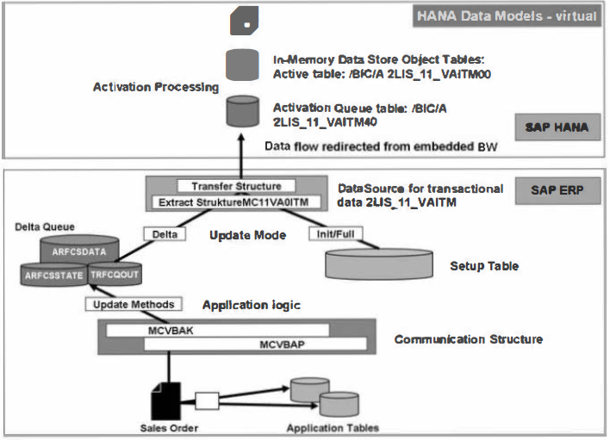
DataSource Extractors Example from Sales Order Item Content

Slide 9
Comparison
Direct Extractor Connection
ETL type: Simple and straightforward ETL
approach; no premium features
SAP DataSources: available for all SAP Business
Content DataSources (Extractors) and Generic
DataSources with a defined key; key can be
defined if missing
Support Package Requirement: SP required in
the source SAP Business Suite system (ECC 6.0
or higher). DXC is implemented by applying a
special SAP note
Delta handling (change data capture): Yes, for
an SAP Business Content DataSources and all
delta processing types; uses an SAP HANA
Optimized DSO with activation processing
Software: Uses existing components in SAP
HANA (XS Engine, ) ; configuration file imported
into SAP HANA
Transformations: very limited - BADI (ABAP) in
extraction exit available. When extensive
transformations are required, it's recommended to use DataServices
SAP Data Services
ETL type: Sophisticated ETL tool with extensive valuable features (data quality, metadata mgmt, transformations. etc.)
SAP Datasources: available for SAP Business
Content DataSources (Extractors), limited to the subset of DataSources released to Operational Data Provider
Support Package Requirement: SP must be
applied to the source SAP Business Suite system - see SAP note 1522554
Delta handling (change data capture): Yes,
except for SAP Business Content DataSources
with delta processing types AIM, AIE, AIED,
AIMD, ADD, ADDO, CUBE
Software : BI 4 Platform 4 and SAP DataServices required
Transformations: extensive transformation
capabilities available in the DataServices ETL tool

Slide 10
Comparison
Direct Extractor Connection
Type: Batch driven ETL Data comes from SAP
delivered Business Content DataSource extractors
Real-Time: No. Once every 15 minutes approx
theoretical maximum time(depends on DataSource)
Delivered Foundational Data Models for SAP
Entities: Yes
Semantically Rich Data: Yes. via SAP delivered
Business Content DataSource extractors
System Landscape: Nothing needed, uses existing components In SAP HANA
Transformations: Limited, BADI in extraction exit available
SAP Landscape Transformation
Type: Trigger-based table replication. Data comes from base tables of SAP Business Suite systems
Real-Time: Yes. Expecting lag time typically less than 3 seconds
Delivered Foundational Data Models for SAP Entities: Generally no, some RDS content available
Semantically Rich Data: No. Semantics must be implemented on a project basis in SAP HANA
System Landscape: SAP NetWeaver 7.01 or
higher required
Transformations: Several functions available for data transformations.

Slide 11
THANK YOU
Courtesy : SAP Labs Document -
HA 350 – Data Provisioning

